Slide 1
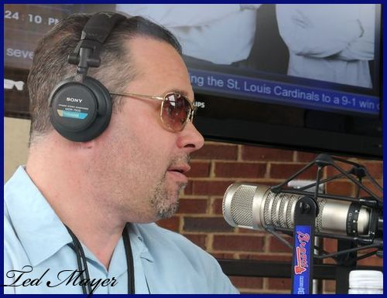
photoblog.com

Slide 2
USAToday.com

Slide 3
?
?
Rely on God’s grace gift of imputed righteousness
Rely on your own merits, righteousness you earn
?
?
Romans 3.23 NET: …all have sinned and fall short of the glory of God.
Romans 3.20 NET: For no one is declared righteous before him [God] by the works of the law.
Romans 3.24 NET: [we can be] justified freely by his grace through the redemption that is in Christ Jesus.

Slide 4
?
?
Rely on God’s grace gift of imputed righteousness
Rely on your own merits, righteousness you earn
?
?
Righteousness from God, by grace, through faith
Righteousness from ourselves by obedience
Philippians 3.9 NASB: I want to be found in him [Christ], not [by] having a righteousness of my own derived from the Law, but that which is through faith in Christ, the righteousness which comes from God on the basis of faith…

Slide 5
Philippians 3.1-3 NET: Finally, my brothers and sisters, rejoice in the Lord! To write this again is no trouble to me, and it is a safeguard for you. Beware of the dogs, beware of the evil workers, beware of those who mutilate the flesh! For we are the circumcision, the ones who worship by the Spirit of God, exult in Christ Jesus, and do not rely on human credentials…
Ruins in ancient Philippi / photo ©2012 Todd Bolen/ BiblePlaces.com

Slide 6
Philippians 3.1-3 NET: Finally, my brothers and sisters, rejoice in the Lord! To write this again is no trouble to me, and it is a safeguard for you. Beware of the dogs, beware of the evil workers, beware of those who mutilate the flesh! For we are the circumcision, the ones who worship by the Spirit of God, exult in Christ Jesus, and do not rely on human credentials…

Slide 7
Philippians 3.2 NET: Beware of the dogs, beware of the evil workers, beware of those who mutilate the flesh!
Judaism
Jews not believing Jesus is the Messiah
Jews believing Jesus is the Messiah, with a false gospel based on the Mosaic Covenant
Jews and Gentiles believing Jesus is the Messiah, with the true gospel based on the New Covenant
Gentile Paganism
Gentiles not believing Jesus is the Messiah

Slide 8
Philippians 3.1-3 NET: Finally, my brothers and sisters, rejoice in the Lord! To write this again is no trouble to me, and it is a safeguard for you. Beware of the dogs, beware of the evil workers, beware of those who mutilate the flesh! For we are the circumcision, the ones who worship by the Spirit of God, exult in Christ Jesus, and do not rely on human credentials…

Slide 9
Philippians 3.2: Beware of the dogs, beware of the evil workers, beware of those who mutilate the flesh!
περιτομή [peh-rih-tuh-MAY] = circumcision
κατατομή [kah-tah-tuh-MAY = mutilation
Magnes.org
Antagonists: Jews believing Jesus is the Messiah,
but with a false gospel based on the Mosaic Covenant

Slide 10
Philippians 3.2: Beware of the dogs, beware of the evil workers, beware of those who mutilate the flesh!
not workers of righteousness by obedience,
workers of evil by misplaced faith in false gospel
Magnes.org
Antagonists: Jews believing Jesus is the Messiah,
but with a false gospel based on the Mosaic Covenant

Slide 11
Philippians 3.2: Beware of the dogs, beware of the evil workers, beware of those who mutilate the flesh!
Antagonists: Jews believing Jesus is the Messiah,
but with a false gospel based on the Mosaic Covenant

Slide 12
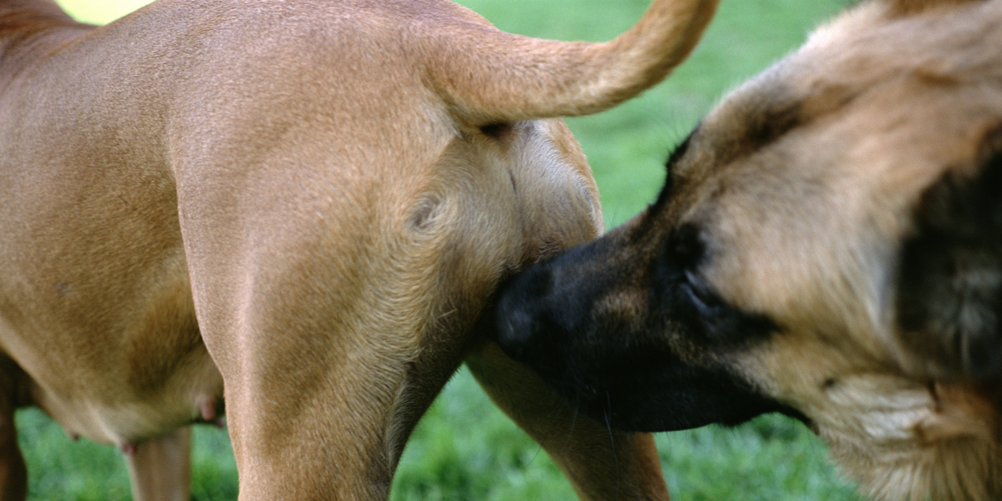
Philippians 3.2: Beware of the dogs, beware of the evil workers, beware of those who mutilate the flesh!
Antagonists: Jews believing Jesus is the Messiah,
but with a false gospel based on the Mosaic Covenant

Slide 13
?
?
Rely on God’s grace gift of imputed righteousness
Rely on your own merits, righteousness you earn
?
?
Paul [top line]:
No righteousness w/o Christ; but Christ’s righteousness if saved in Christ
Adversaries [bottom line]:
Earn righteousness
by what you do
Philippians 3.9 NASB: I want to be found in him [Christ], not [by] having a righteousness of my own derived from the Law, but that which is through faith in Christ, the righteousness which comes from God on the basis of faith…

Slide 14
Philippians 3.1-3 NET: Finally, my brothers and sisters, rejoice in the Lord! To write this again is no trouble to me, and it is a safeguard for you. Beware of the dogs, beware of the evil workers, beware of those who mutilate the flesh! For we are the circumcision, the ones who worship by the Spirit of God, exult in Christ Jesus, and do not rely on human credentials…

Slide 15
Philippians 3.1-3 NET: Finally, my brothers and sisters, rejoice in the Lord! To write this again is no trouble to me, and it is a safeguard for you. Beware of the dogs, beware of the evil workers, beware of those who mutilate the flesh! For we are the circumcision, the ones who worship by the Spirit of God, exult in Christ Jesus, and do not rely on human credentials…

Slide 16
Philippians 3.1-3 NET: Finally, my brothers and sisters, rejoice in the Lord! To write this again is no trouble to me, and it is a safeguard for you. Beware of the dogs, beware of the evil workers, beware of those who mutilate the flesh! For we are the circumcision, the ones who worship by the Spirit of God, exult in Christ Jesus, and do not rely on human credentials…

Slide 17
Philippians 3.1-3 NET: Finally, my brothers and sisters, rejoice in the Lord! To write this again is no trouble to me, and it is a safeguard for you. Beware of the dogs, beware of the evil workers, beware of those who mutilate the flesh! For we are the circumcision, the ones who worship by the Spirit of God, exult in Christ Jesus, and do not rely on human credentials…

Slide 18
?
?
Rely on God’s grace gift of imputed righteousness
Rely on your own merits, righteousness you earn
?
?
Righteousness from God, by grace, through faith
Righteousness from ourselves by obedience
Philippians 3.9 NASB: I want to be found in him [Christ], not [by] having a righteousness of my own derived from the Law, but that which is through faith in Christ, the righteousness which comes from God on the basis of faith…

Slide 19
Philippians 3.1 WBG: Henceforth, my brothers and sisters, rejoice in the Lord!
christianpost.com

